Slide 1
soundScore

Slide 2
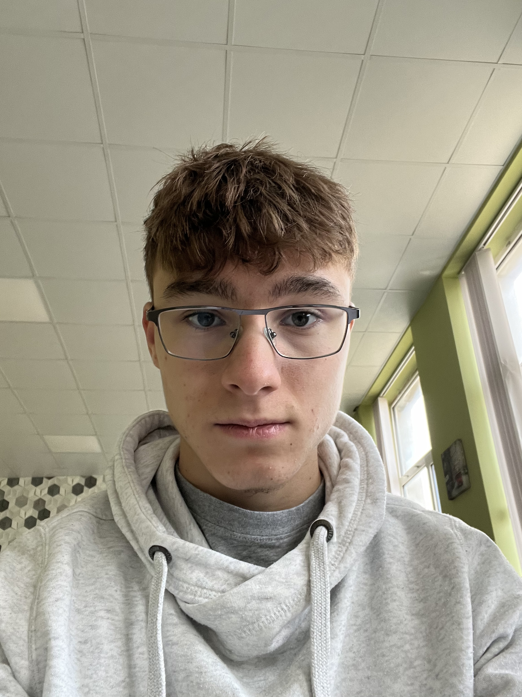
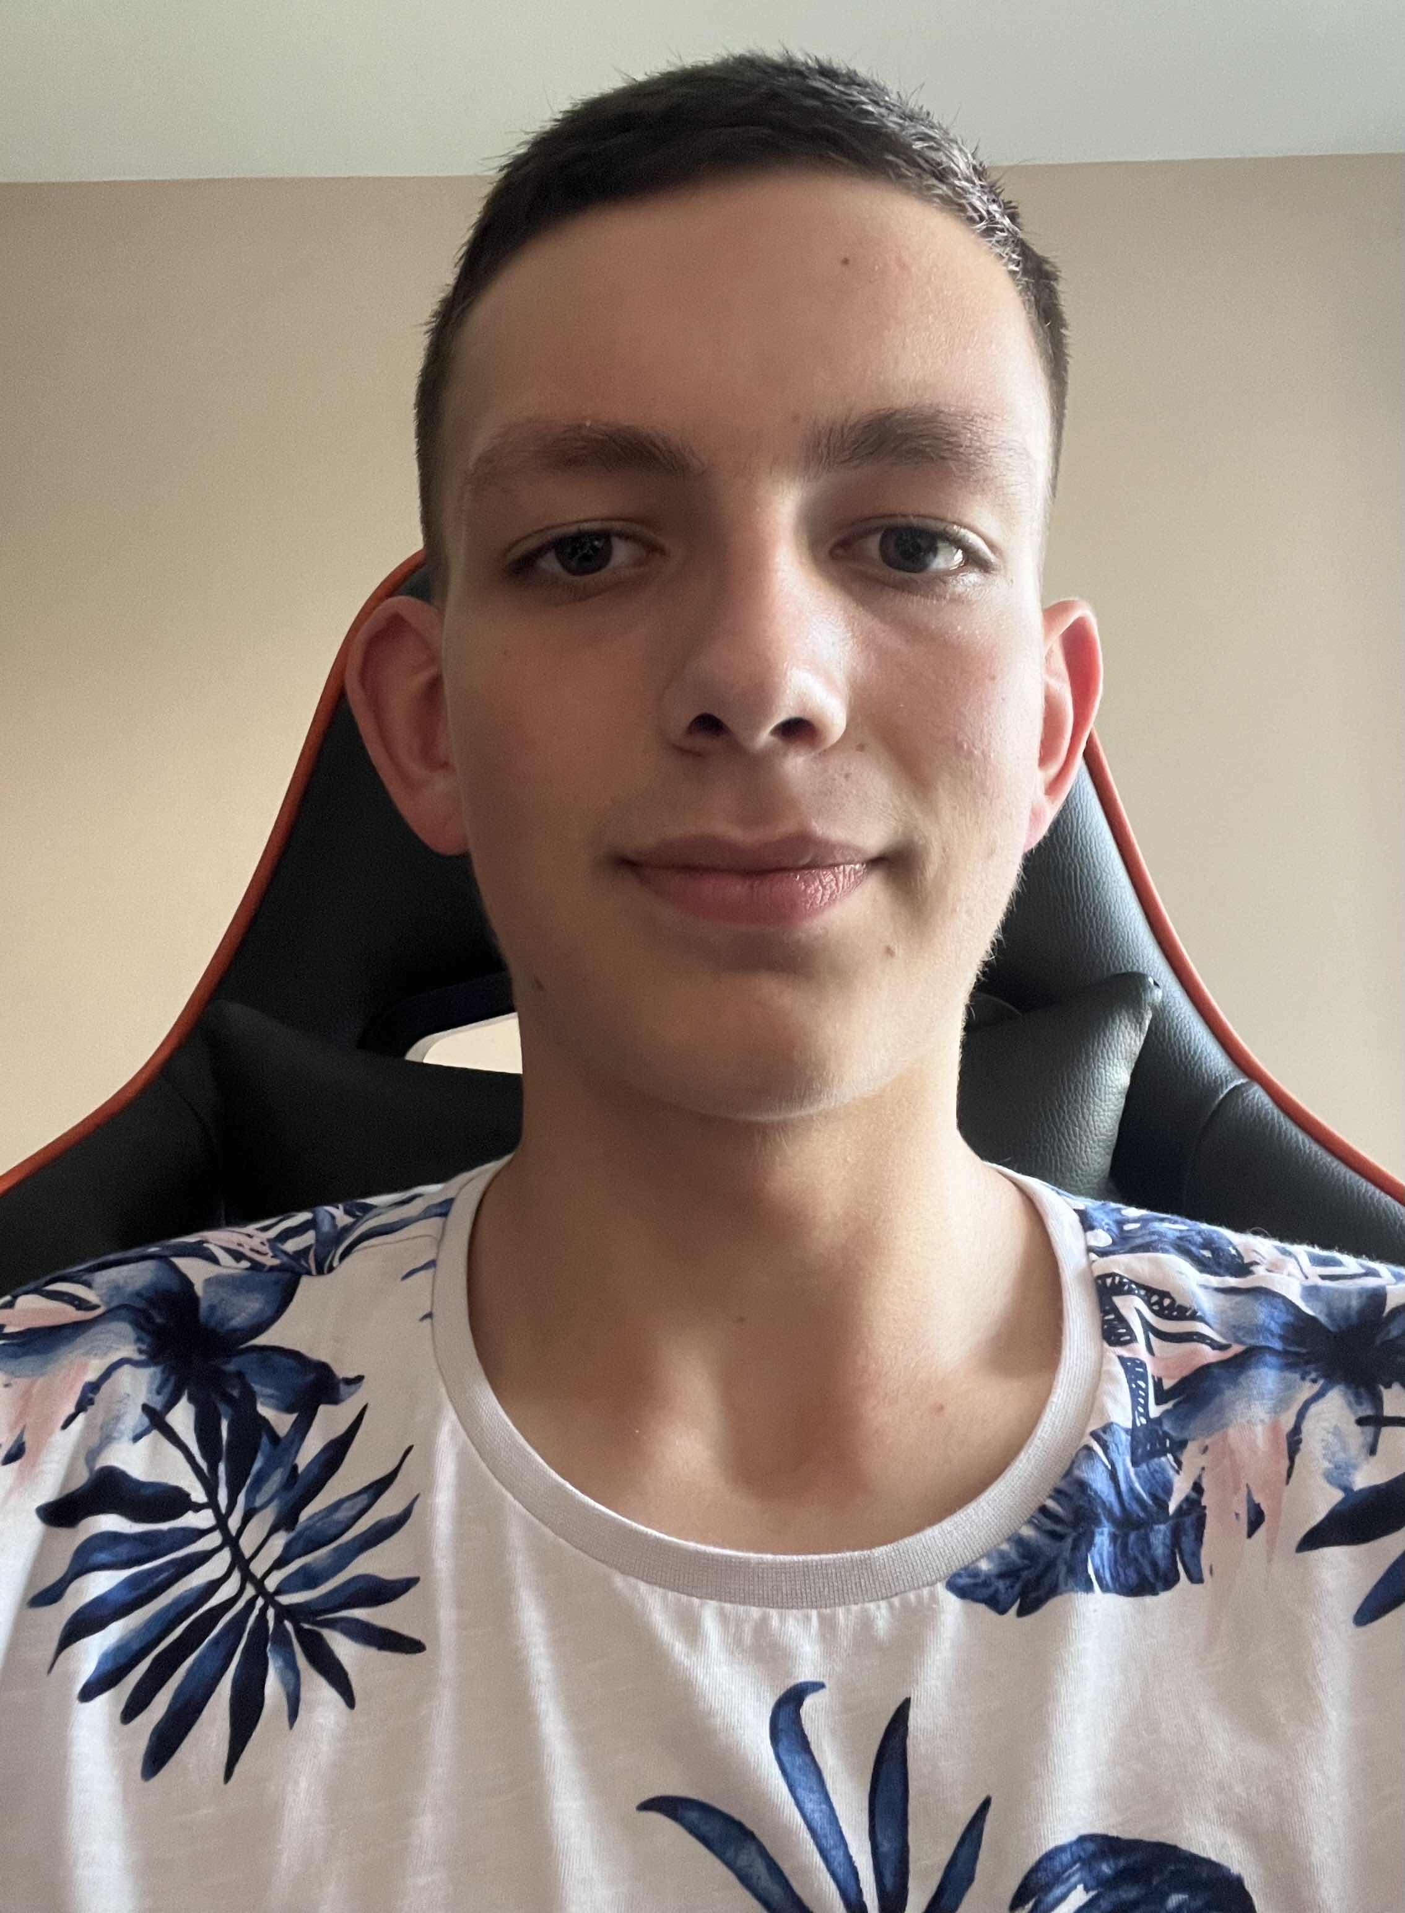
Our Team
Petar Kashlov
Kiril Todorov

Slide 3





Technologies used
https://github.com/Sc0utaa/SoundScoreProject.git

Slide 4

Technologies used
ASP.NET CORE
MVC
HTML, CSS

Slide 5
Demo

Slide 6
THANK YOU

